Slide 1

Is Tesla Equity Outperforming the Market for the next 5, 10 and 15 Years?

Slide 2
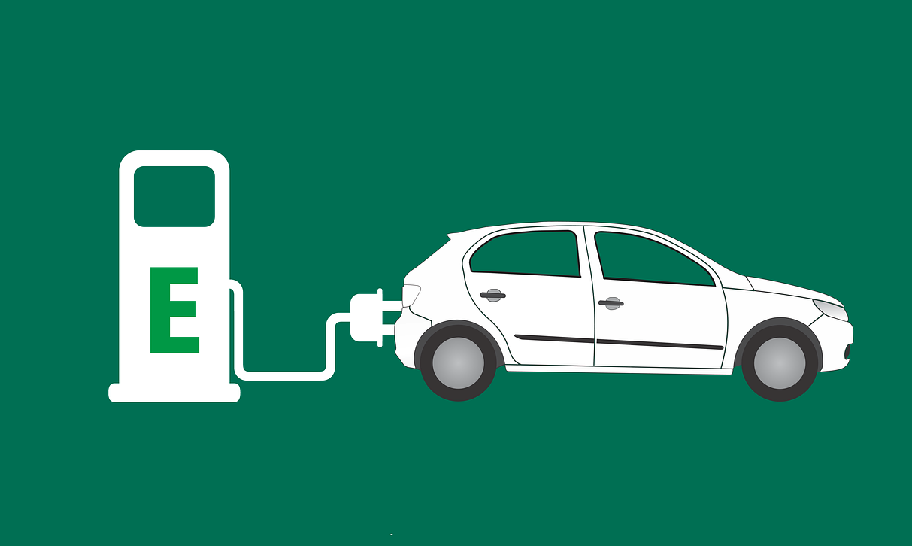
Team members:
Minh Tran
Syed Naqvi
Rodrigo Guazzelli
Hsuan Liu
Abdullah Mamun

Slide 3
Data needed:
Growing Industry
Market size, CAGR of EV market (Global and US market),
Yearly sales of EV vs gas vehicle – to show the uptrend of EV sales?
EV sales portion vs New car sales
Diversification Effect:
TSLA revenue breakdown by region, customer breakdown by region (use the map)
Other regional data ?
Social Impact:
CO2, environment, death rate of TSLA
Financial:
TSLA Financials: EBITDA, capex, profitability, risk of the investment
TSLA valuation- comps model
Stock Price Performance and Simulation:
Historical stock price of TSLA and S&P500 and TSLA’s main competitor from 2015-2020
Monte Carlo simulation for the next 5, 10 and 20 years

Slide 4
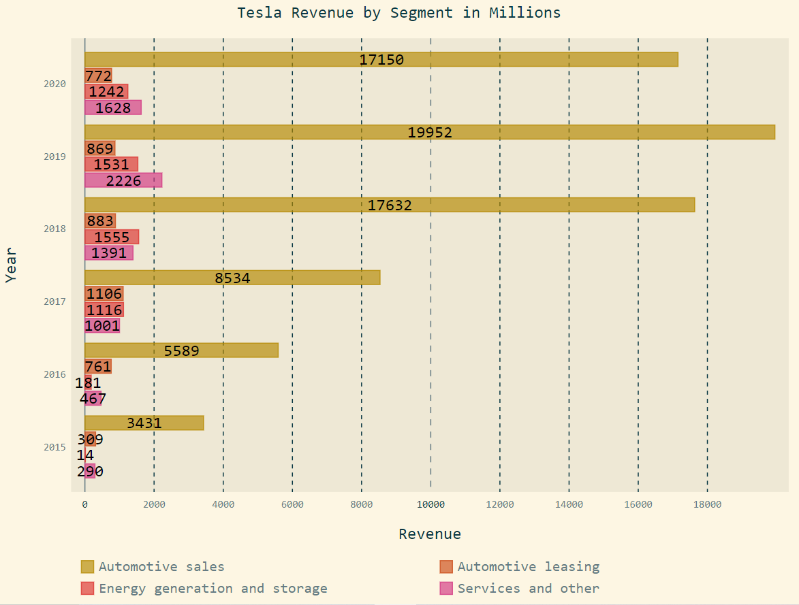
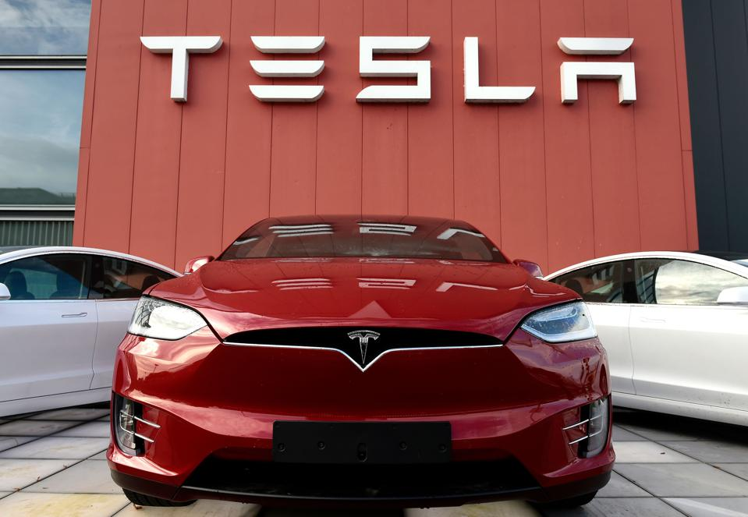
Tesla possible future incomes:
In-house car insurance
Robo-taxi
Ride-hailing Vehicles and Services
FSD & Software as a service
Industry batteries
Computer chips for FSD

Slide 5
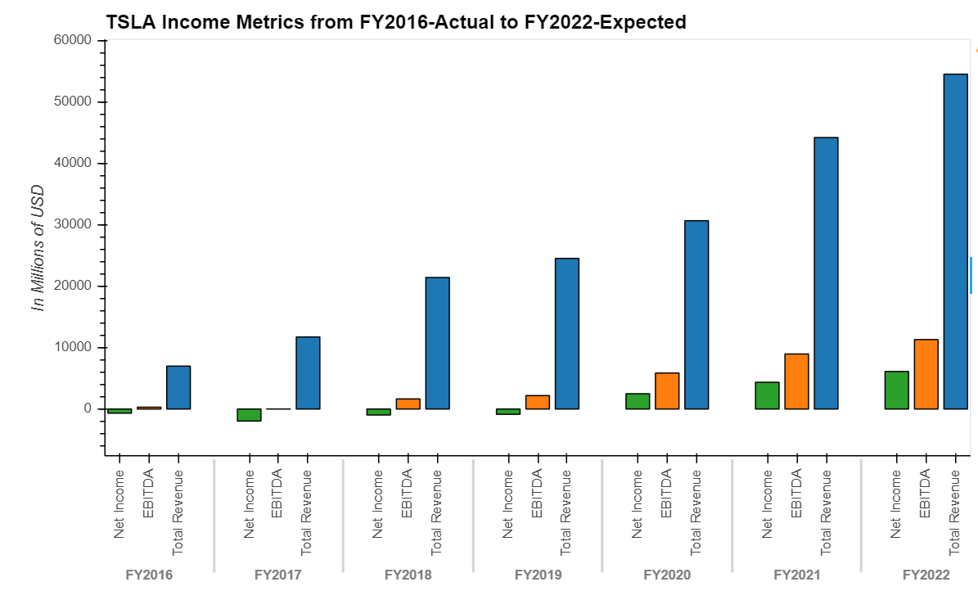
TSLA-Financial Analysis
Income Metrics- Net Income, EBITDA, Revenue
Profitability
Revenue CAGR
Capex
EBITDA YoY
Net Income has turned positive in FY2020
Description to be added
5
Source ：FactSet, Equity Research Report, FS. Note 1, adjusted EBITDA = EBITDA excludes share based payments

Slide 6
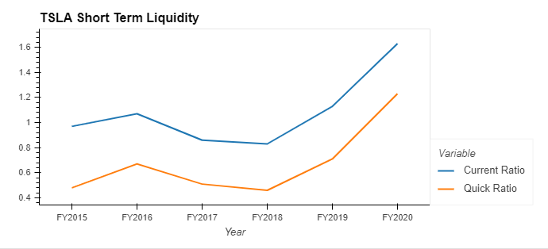
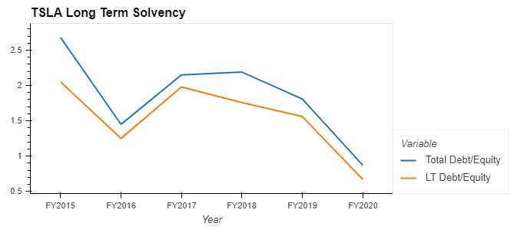
TSLA-Financial Analysis
Short-term Liquidity Analysis
Long-term Solvency
Description to be added
Description to be added
6
Source ：FactSet, Equity Research Report, FS

Slide 7
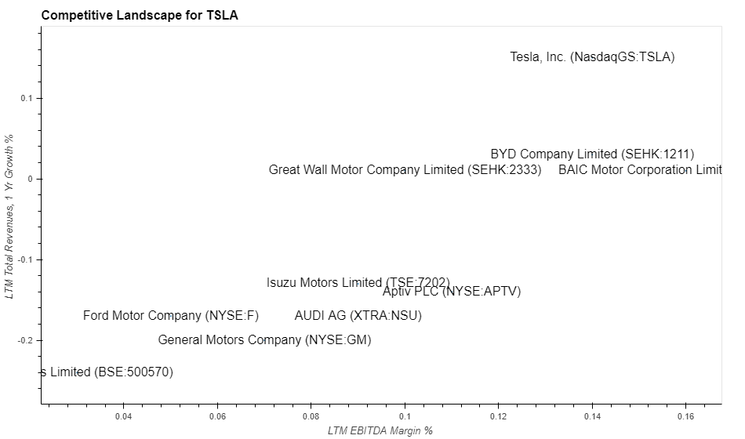
TSLA- Competitive Landscape
First Tier Company - TSLA
Selected Competitors
General Motors Company
Ford Motor Company
BAIC Motor Corporation
Aptiv PLC
BYD Company
Great Wall Motor Company
Isuzu Motors
AUDI AG
Tata Motors
Highlights
TSLA has EBITDA margin around 14% and revenue YoY of 15%, serving as an industry leader
Compared to industry median of 9.5% EBITDA Margin and -13.5% 1-year Revenues Growth, TSLA becomes competitive and first tier candidate
7
Notes:
General Motors Company
Ford Motor Company
BAIC Motor Corporation Limited
Aptiv PLC
BYD Company Limited
Great Wall Motor Company Limited
Isuzu Motors Limited
AUDI AG
Tata Motors Limited
LTM EBITDA Margin % 0.095 LTM Total Revenues, 1 Yr Growth % -0.135

Slide 8
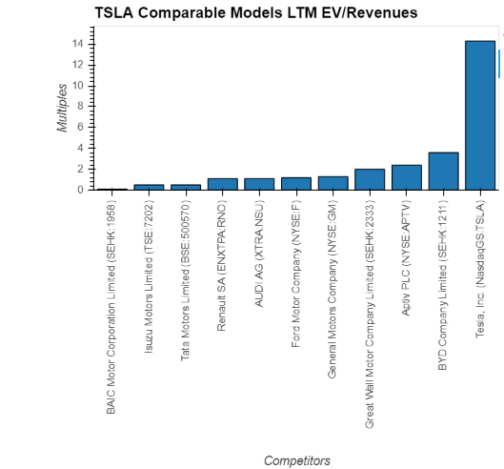
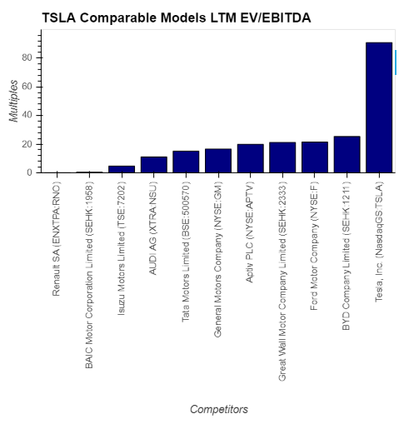
TSLA-Comparable Models
Valuation Highlights - EV/Revenues LTM is 14.3x
Valuation Highlights - EV/EBITDA LTM is 90.8x
Industry Median:1.2x
Industry Median:16.6x
8
Source ：FactSet, Equity Research Report, FS
Notes:
TEV/Total Revenues LTM – Latest 14.3
TEV/EBITDA LTM – Latest 90.8
Industry 50th percentile
TEV/Total Revenues LTM - Latest 1.2 TEV/EBITDA LTM - Latest 16.6

Slide 9
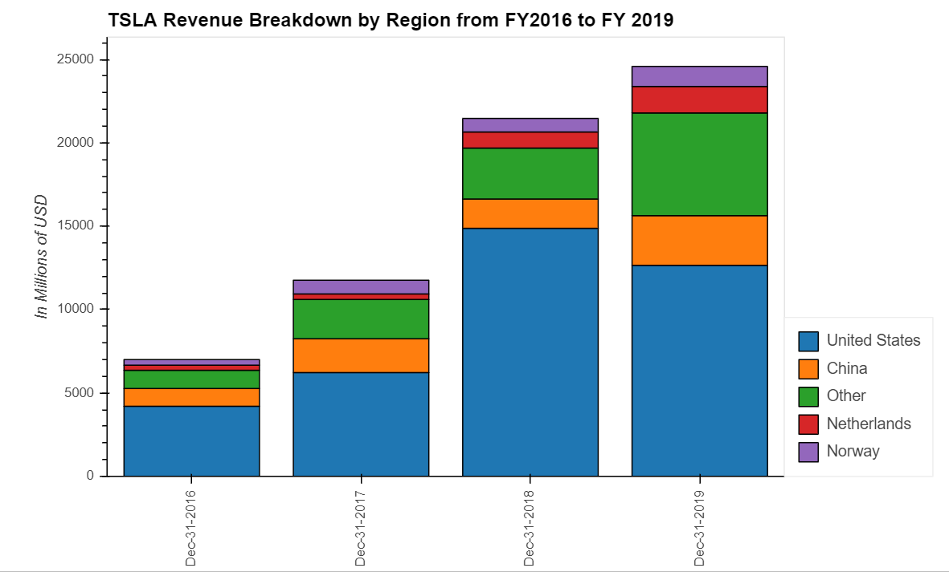
TSLA-Financial Analysis (Prob don’t need this page)
Revenue breakdown by region
9
Source ：FactSet, Equity Research Report, FS. Note 1, adjusted EBITDA = EBITDA excludes share based payments

Slide 10
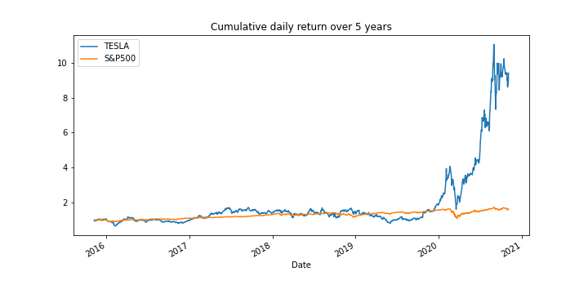
TSLA-Historical price Analysis for the last 5 years
TSLA vs S&P500
Source ：Alpaca trade API / Yahoo Finance

Slide 11
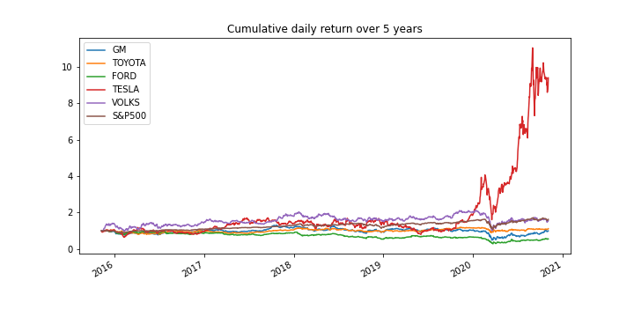
TSLA-Historical price Analysis for the last 5 years
TSLA vs main competitor
Source ：Alpaca trade API / Yahoo Finance

Slide 12
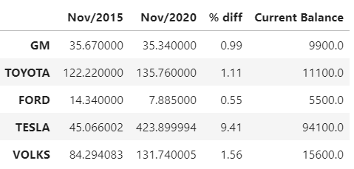
TSLA-Historical price Analysis for the last 5 years
Stock price
If you had invested $10,000 in TESLA stock 5 years ago your current balance would be $94,100
Source ：Alpaca trade API / Yahoo Finance

Slide 13
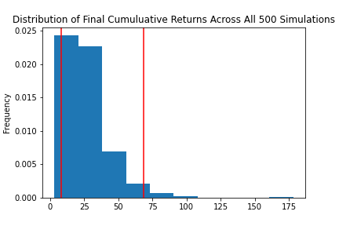
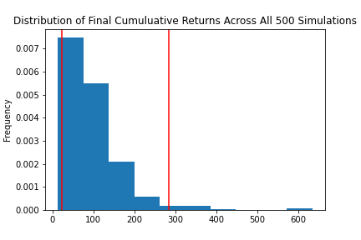
TSLA-Sensitivity Analysis for next 20 years
Monte Carlo Simulation Portfolio Without Tesla
Monte Carlo Simulation Portfolio With Tesla
With an initial investment of $10,000 in your portfolio you have a 95% chance it will be within the range of $82,972.21 and $683,666.61 over the next 20 years
With an initial investment of $10,000 in your portfolio you have a 95% chance it will be within in the range of $226,781.95 and $2,835,449.51 over the next 20 years
Portfolio = Apple Inc. , Alphabet Inc. , Johnson & Johnson , Berkshire Hathaway Inc.
Source ：Alpaca trade API / Yahoo Finance

